Slide 1
Non-erythropoietic erythropoietin derivatives protect from light-induced and genetic photoreceptor degeneration
Authors: Pasqualina Colella, Carolina Iodice, Umberto Di Vicino, Ida Annunziata, Enrico M. Surace, and Alberto Auricchio
Presented by: Karah Thieme
Colella, Pasqualina, et al. “Non-erythropoietic erythropoietin derivatives protect from light-induced and genetic photoreceptor degeneration.” Human Molecular Genetics 20.11 (2011): 2251-2262.

Slide 2
Outline
Introduction
Background
Objectives
Results
Conclusion
Opinion

Slide 3
Background
Inherited Retinal Degnerations (IRDs)
Photoreceptor (PR) apoptosis
Heterogenous
Mutations found in 208 genes thus far
Treatment possibilities are preferably general, not mutation-specific
Erythropoietin (EPO)
Hormone that promotes PR protection
Systemic side effects to treatment
Increased hematocrit levels
Increased thrombotic risk
Platelet hyper-reactivity

Slide 4
Background
Erythropoietin Derivatives (EPO-Ds)
Hope to have same protective function without the side effects
No or lower erythropoietic activity
Generated 3 EPO-Ds
Mutant EPO S100E
NP1 - helix-B derived peptides
NP2 - helix-A derived peptides

Slide 5
Objectives
Determine if delivery of a non-erythropoietic EPO-D could be a treatment for IRDs
Preferable as it would not produce side effects as EPO does
Learn more about EPO’s different functions in retinal protection
Such as how erythropoietic activities compare to non-erythropoietic activities

Slide 6
Results 1
Analyze retinal expression profile of known EPORs to determine:
If a local effect can be applied after SR AAV-mediated delivery of EPO and EPO-D
What are the EPO and EPO-D target cells

Slide 7
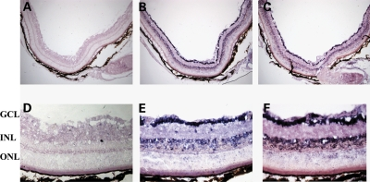
Results 1
Fig.1 – EPOR and βCR expression pattern in adult murine retina
A &D: EPOR and βCR sense control peptides
B & E: EPOR antisense probe
C & F: βCR antisense probe

Slide 8
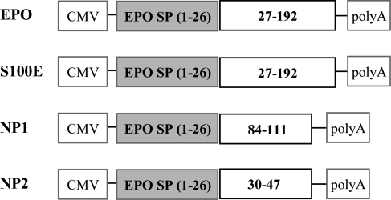
Results 2
Assess hematocrit levels, functional and morphological PR preservation after EPO and EPO-D delivery
Fig. 2 – AAV2/1 vectors produced for gene transfer

Slide 9
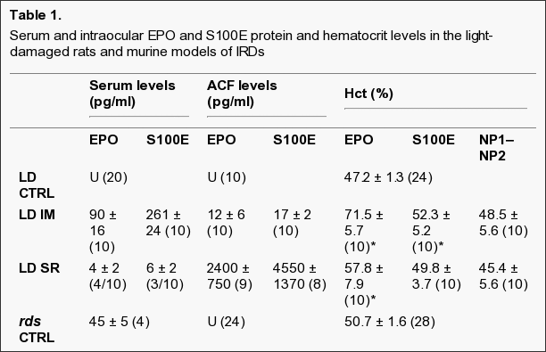
Results 2
Table 1 –
Systemically injected- increased EPO and S100E protein levels in sera increased; significant hematocrit increase (EPO)
Subretinally injected- increased EPO and S100E protein levels in ACF
NP1 and NP2- were not measured; anti-EPO antibodies do not bind to the peptides

Slide 10
Results 2
Fig. 3 – Retinal function and morphological protection after AAV delivery in light-damaged albino Lewis rats
B wave – represents global retinal function
A wave – represtents PR function
Subretinal- vectors encoding EPO or S100E resulted in preservation of retinal function
Systemic- vectors encoding EPO or S100E also resulted in preservation of retinal function after light damage to a greater extent than subretinal

Slide 11
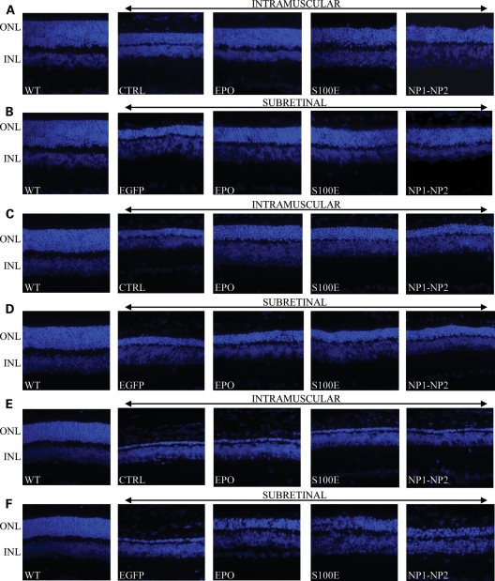
Results 2
Fig. 4 – Representative Retinal Histology after AAV delivery
A&B: light-damage
C&D: rds mice
E&F: Aipl1^{-/-}
Figure shows there is PR preservation across all treated mice compared to controls (CTRL)

Slide 12
Results 3
rds (retinal degeneration slow) mice
Aipl1^{-/-} knockout mice
homozygous for a null mutation in the peripherin 2 gene
causes progressive PR loss
lacks retinal function and exhibits fast degeneration of PRs due to the destabilization of phosphodiesterases
Enzyme needed for PR survival and function

Slide 13
Results 3
Hematocrit Levels
Significant increase after systemic or SR injection of EPO vectors
Increase, but not as great with systemic injection of S100E vector
No significant increase for systemic or SR injection of NP1 and NP2 or for SR injection of S100E

Slide 14
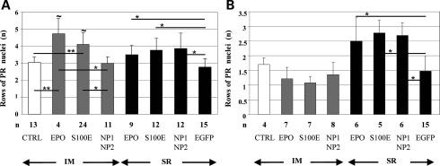
Results 3
Fig. 5
(A) rds mice showed significantly higher PR preservation than controls
Exception being systemic injection of vector for NP1 and NP2
Higher levels after systemic injection of EPO and S100E in company of a hematocrit increase
Confirms systemic activities in combination with local functions provides a greater retinal rescue

Slide 15
Conclusion
PR protection resulted after systemic delivery of S100E in the three different models of retinal degeneration
Suggests erythropoietic activity is not necessary
Possibility of avoiding the unwanted side effects associated with delivery of EPO
NP1 and NP2 did not produce any real effect or protection to the extent of EPO or S100E
Though it provided some PR preservation compared to controls (Results 2; Fig. 4)

Slide 16
Conclusion
Systemic injection was consistently better than intraocular
Possible reasons:
non-erythropoietic systemic functions of the hormones may be involved and aid in the protective effect
may be tissue-specific modifications that alter the proteins after transduction of muscle or retina
an inverse relationship between the hormones effectiveness and their concentrations with the highest effectiveness obtained at the lowest intraocular concentrations
Exception of Aipl1 mice, where SR injection was better because it provided a faster, more direct treatment (Results 3; Fig. 5B)

Slide 17
Opinion
Further Research
Should further study the possibilities with S100E
Lower erythropoietic activity allows one to avoid the undesirable side effects
Compare overall effectiveness of EPO versus S100E
Concentrate on AAV delivery via systemic route
Consistently provided a stronger PR protective/preservation effect
Exception: if examining and IRD that has a fast degeneration process, then SR route may be better as it is a more direct method

